Slide 1
Pygame
workshop
DSD

Slide 2
BATTLE TANK
SHOOTING GAME

Slide 3
TEAM NAME:
s cube
TEAM NUMBER:
26

Slide 4
Team members
sanjay.j
samuvel.s
sai BGM hemamalini

Slide 5
`
ACADAMIC MENTOR:
Mr.RAJASEKARAN
Dept of IT,kgisl

Slide 6
INDUSTRY MENTOR: MR
INDUSTRY MENTOR:
Ms.Subhashini.U
associate
Kgisl gss

Slide 7
ABSTRACT
BATTLE TANKER
This project is based on battle tank in war.It is a python game with graphics and user interaction.It is a basically battle game and it has two player controlled by keyboard actions It has shooting function tankers have bombing functionality manyobjective of each player by shooting other tank and make them every cause one life for user but the life are limited

Slide 8
In battle tank the toughness of the will be increased Once the certain score is reached then the player will move to next stage.
Once the player lost he will reappear for three time because in this game you have three life. In this game we can improve our speed because tanker will be moving speeder than you .This game is easily playable .It is an 2d game .

Slide 9
INTRODUCTION
The flow of the Pygame workflow is an amazing way for beginners to learn game programming at a deeper level because it is straightforward while also having a fair amount of depth. Pygame does not come with Python. Like Python, Pygame is available for free. You will have to download and install Pygame, which is as easy as downloading and installing the Python interpreter.

Slide 10
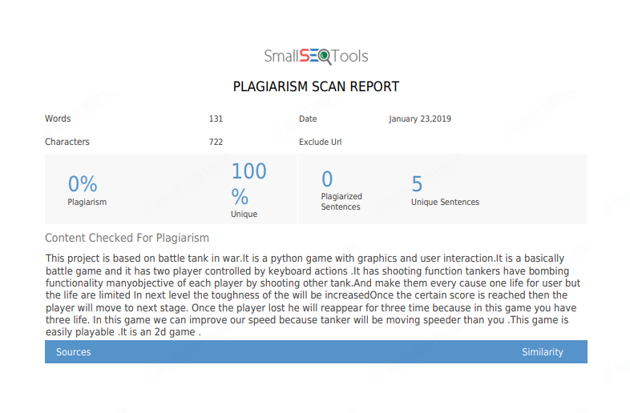

Slide 11
MODULES
One vs one
Two players will face each other.
The single player will attack the opponent differentiated than the other tanker.
The each players have three life.
In this both players will be in green color.
In this game the tanks will move faster .

Slide 12
MODEL ARCHITECTURE
START
ONE VS ONE BATTLE
TWO PLAYERS
SHOOTING GAME
END THE GAME

Slide 13
Statement:
we developed the simple tanker battle game using python pygame.
:

Slide 14
REQUIREMENT
HARDWARE :
PENTIUM 4
SOFTWARE :
THONNY
LANGUAGE:
PYTHON PROGRAMMING.

Slide 15
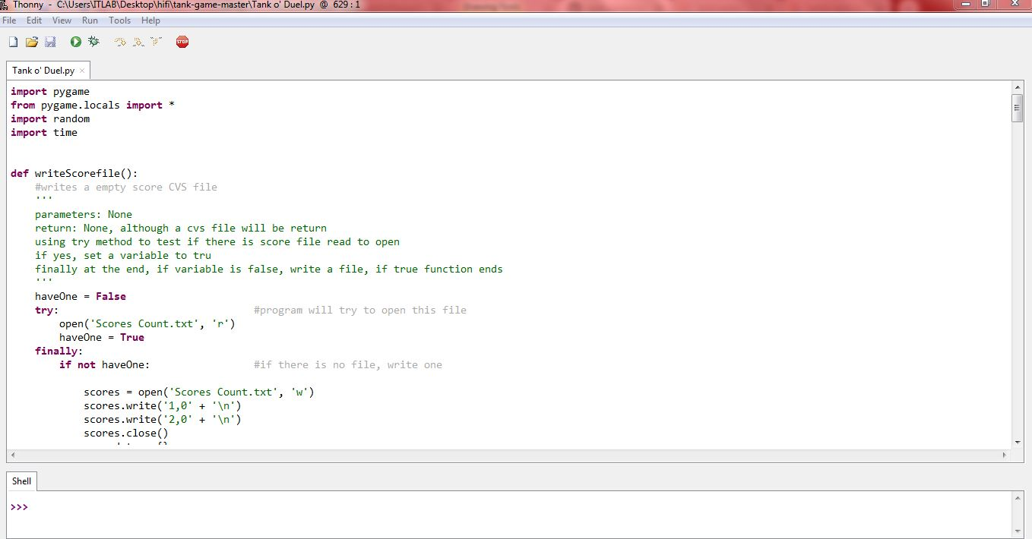
Source code

Slide 16
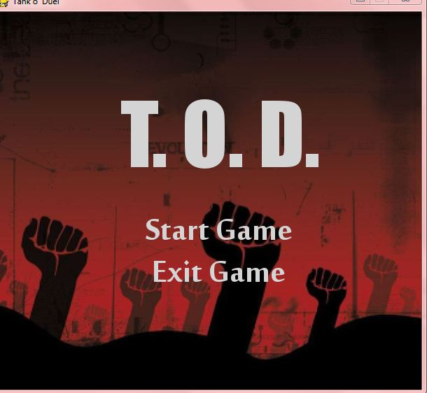
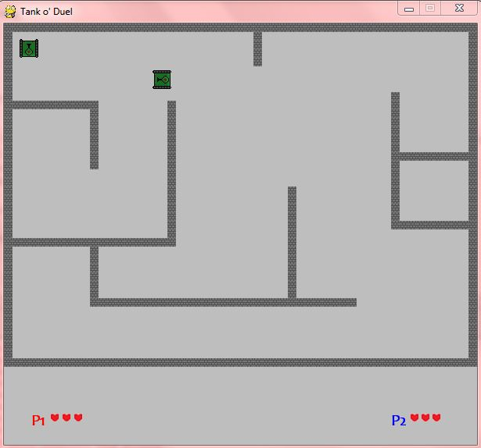
Pygame (screen shot)

Slide 17
FEATURES:
FEATURES:
interactive game
ONE VS ONE
Battle with each other

Slide 18

THANK YOU

